Slide 1
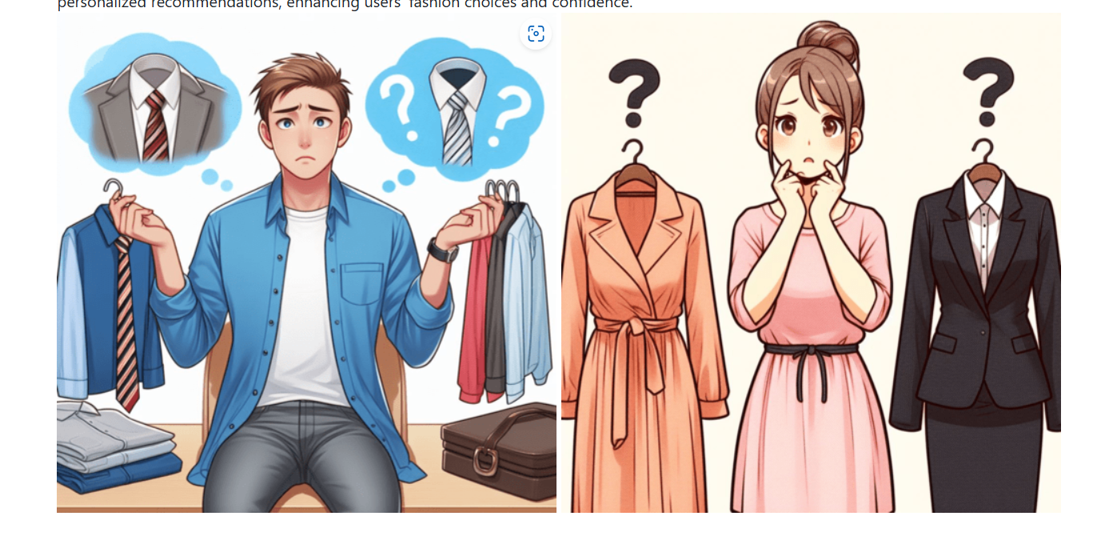
Confused about what to wear ?

Slide 2
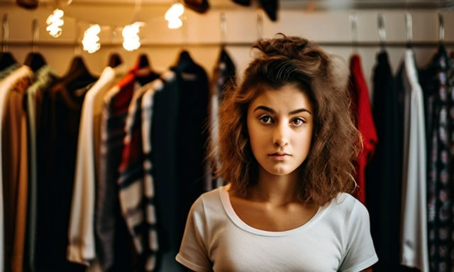
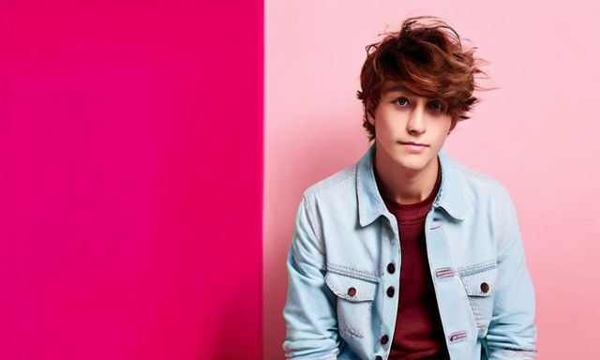
Colors Combination and Advisior For Clothing Selection A halt for daily confusion while getting r ready for Various occasion

Slide 3
Abstract
Choosing the right color combination for clothing can greatly impact one's appearance and confidence in various settings. This project aims to develop a machine- learning model that helps users select the optimal color combinations for different occasions such as meetings, casual outings, or formal events. By analyzing color psychology and fashion trends, the model suggests the most suitable color combinations based on the user's preferences and the context of the event. The project utilizes machine learning algorithms and other technologies to provide personalized recommendations, enhancing users' fashion choices and confidence.

Slide 4
Data Collection
Data Visualization
Data Pre Processing
Modelling and Data Training
Testing

Slide 5
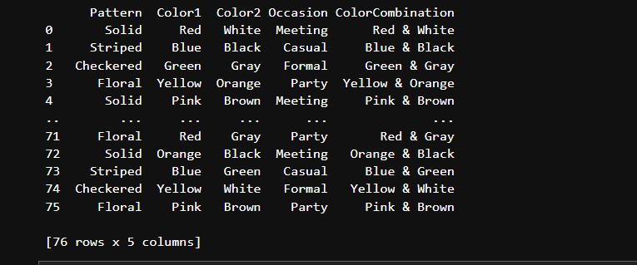
Data Set Used

Slide 6
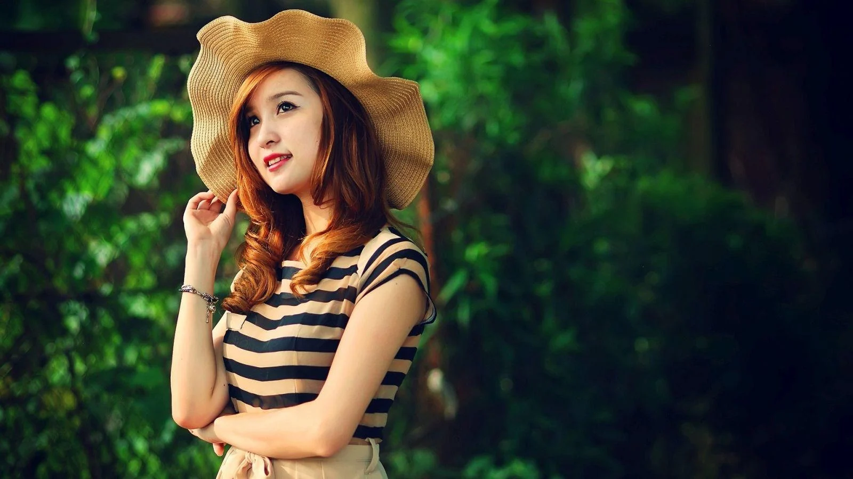
Importing Liberaries & Data Cleaning
Importing Libraries & Data Cleaning to inspect and understand the structure and content of a dataset using the functions : 1. head: displays first few rows of DataFrame giving the overview of its structure and contents. 2. info: provide concise summary of DataFrame including its 3. size, data types, and memory usage. description: shows descriptive statistics summarizing the central tendency, dispersion and shape of DataFrame's distribution of numerical data.

Slide 7

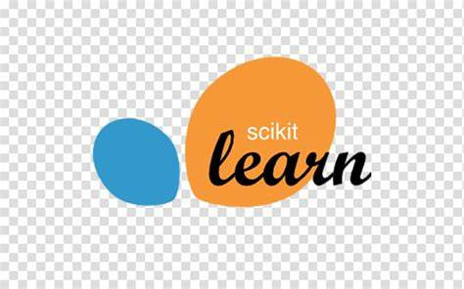

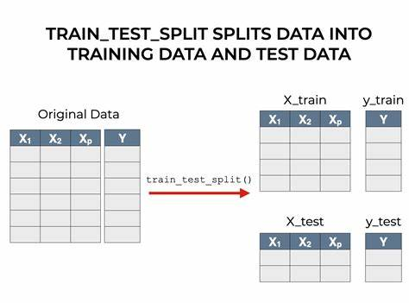

Dependencies

Slide 8
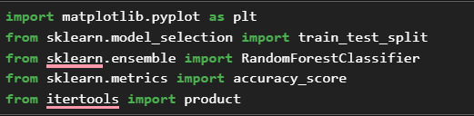
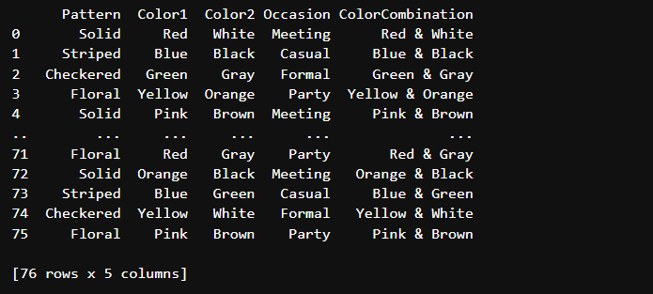
Import Library and Import data

Slide 9
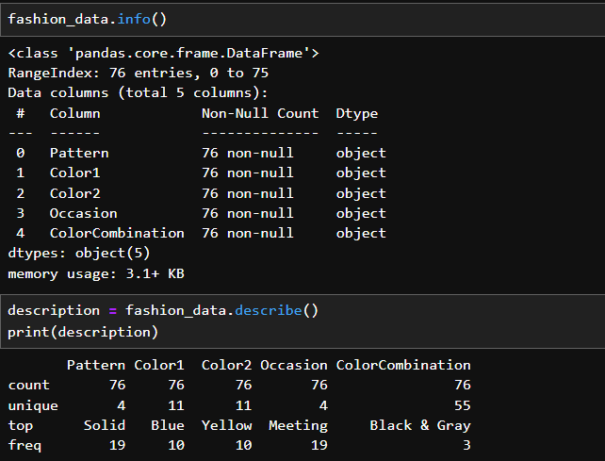

Slide 10
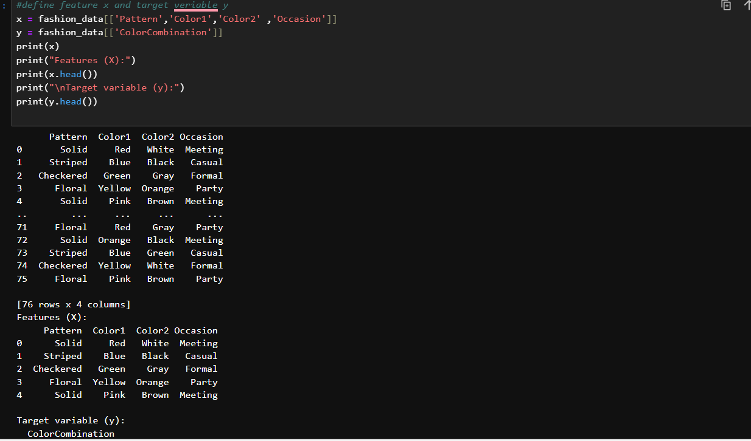

Slide 11
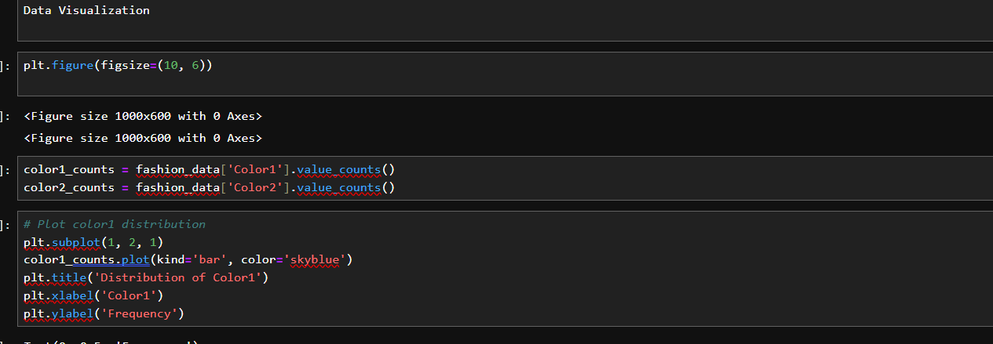

Slide 12
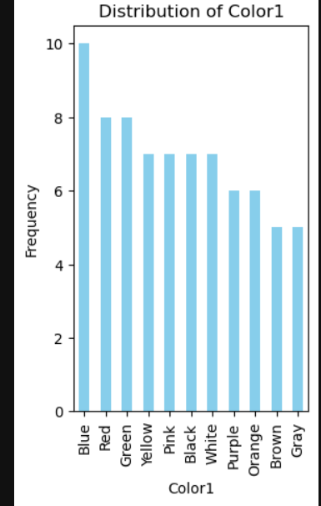
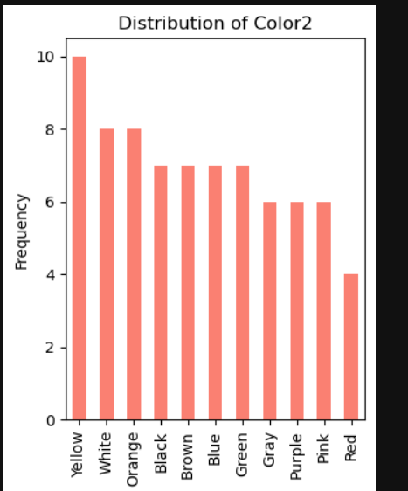

Slide 13
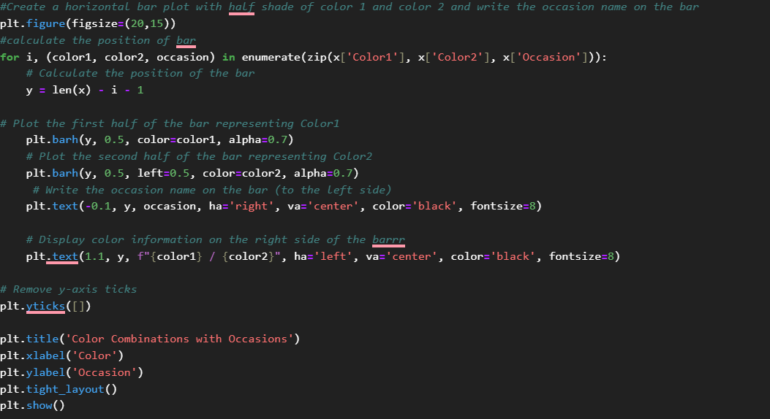

Slide 14
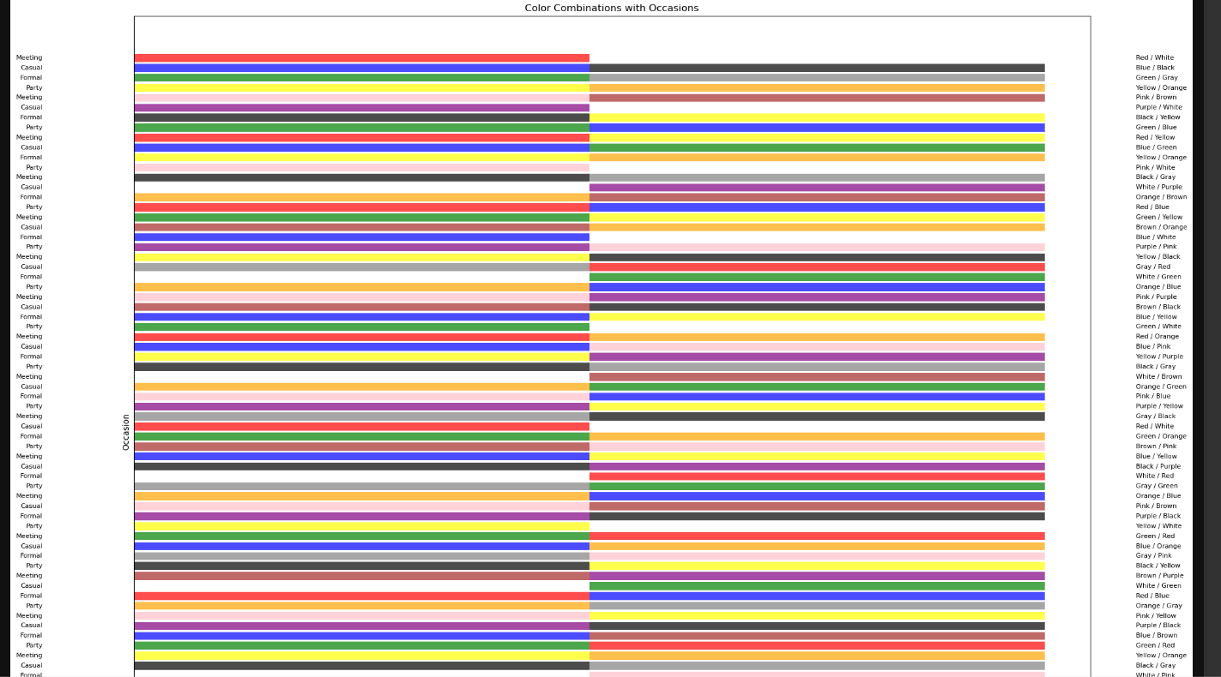
Colour Combination
Ocassion

Slide 15
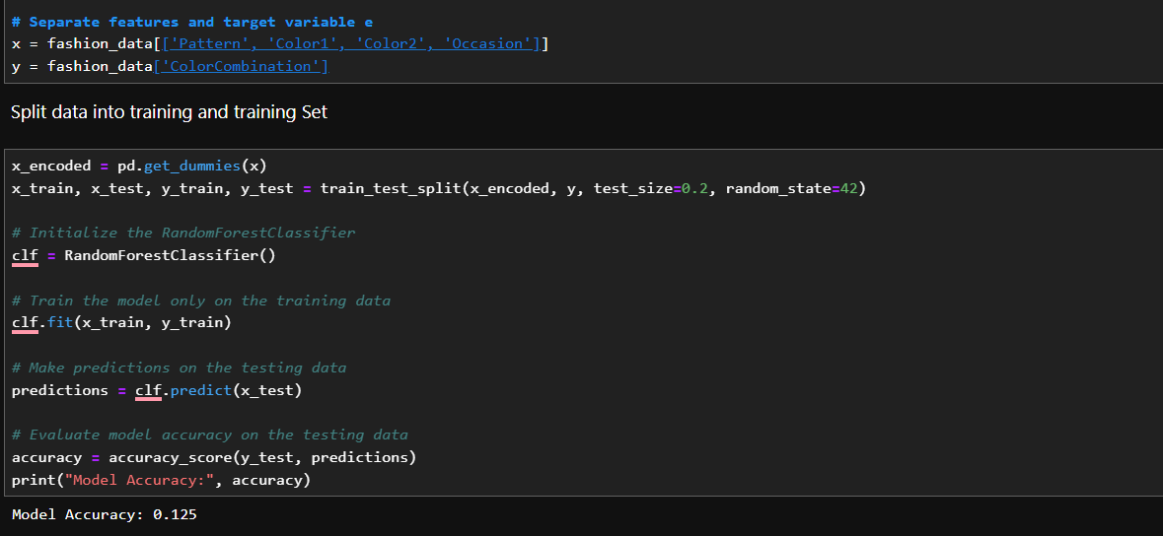

Slide 16
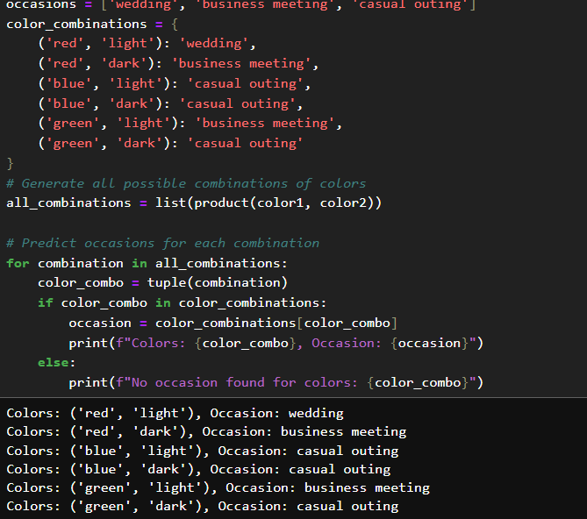

Slide 17
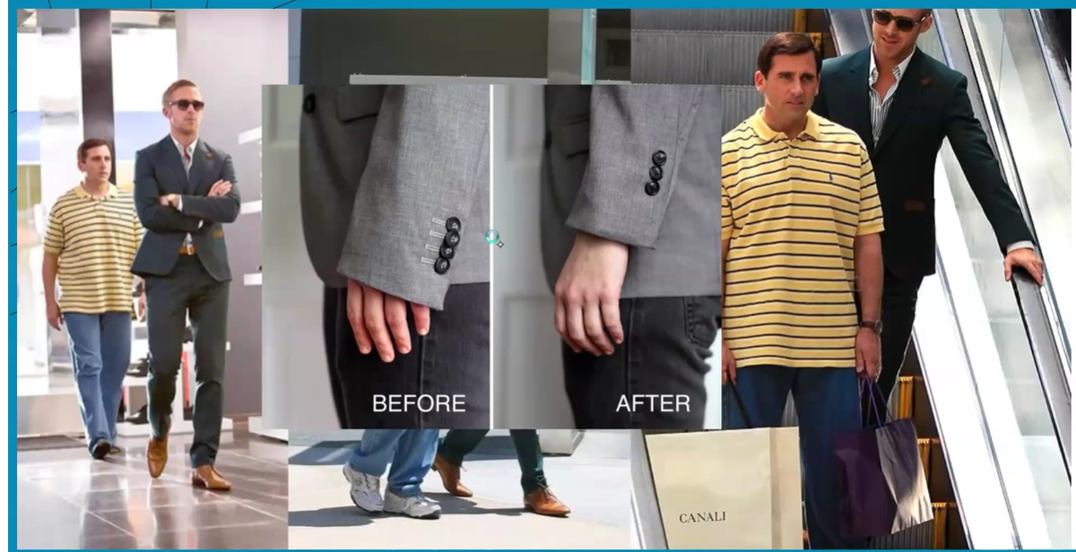

Slide 18
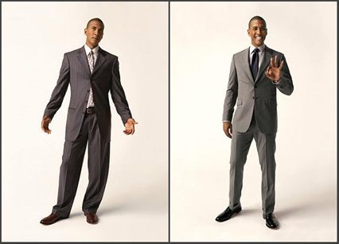

Slide 19
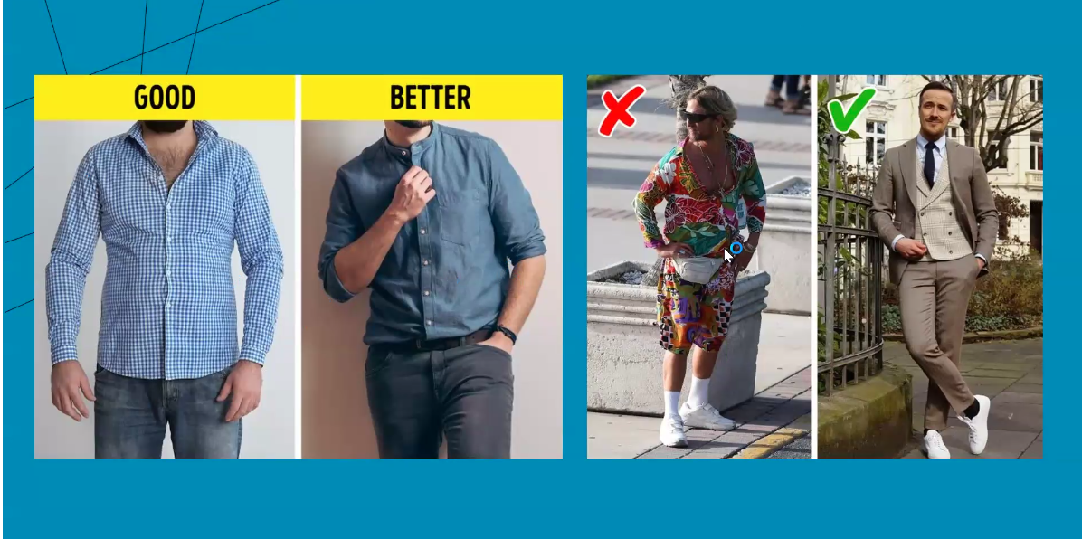

Slide 20
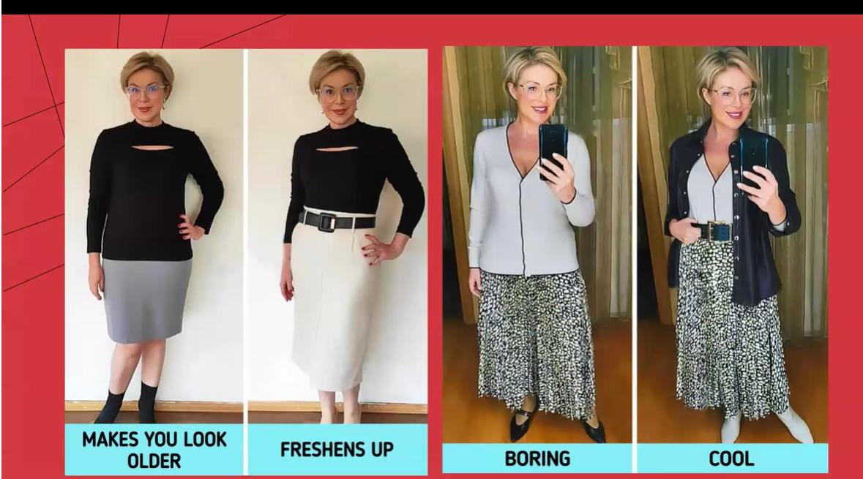

Slide 21
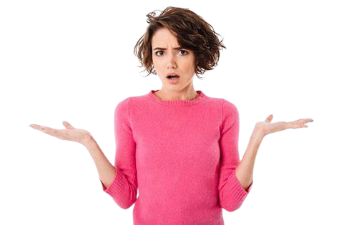
What Should I wear at Casual Outing today ?

Slide 22
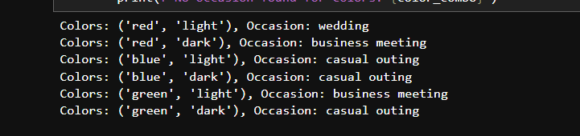
Result Showing all Possible Colour Combination

Slide 23
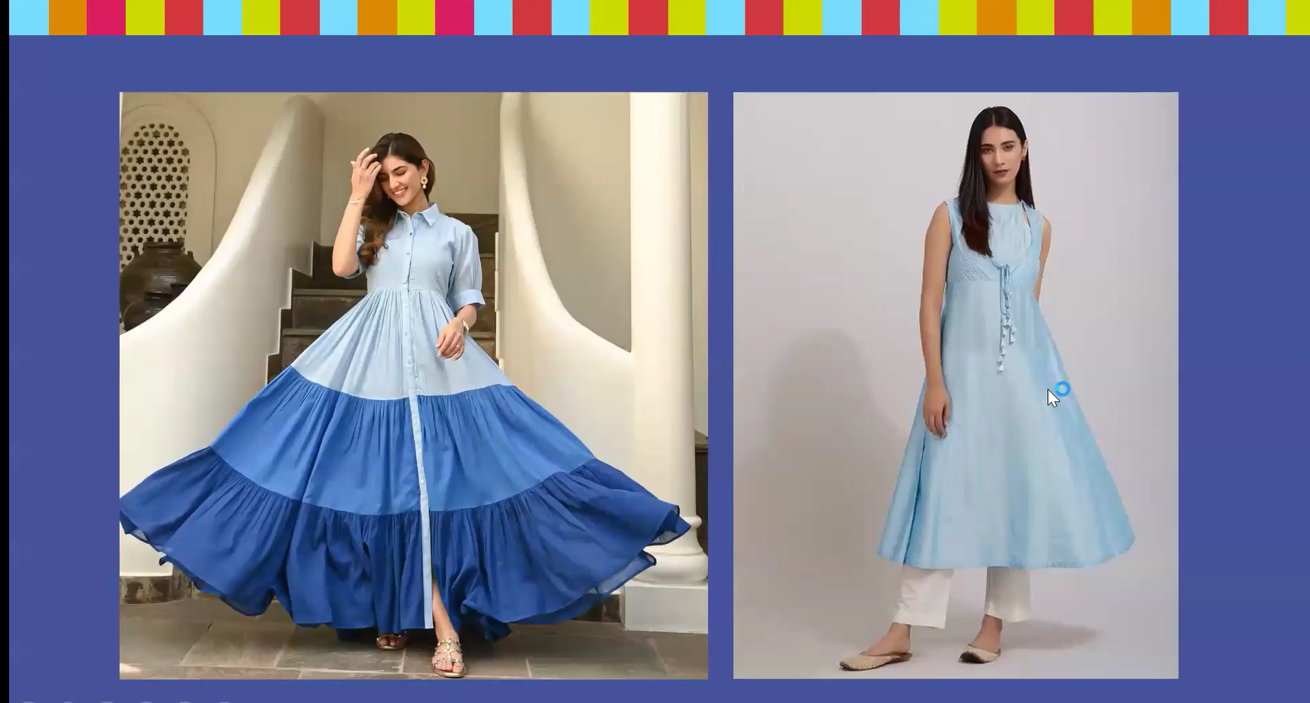

Slide 24
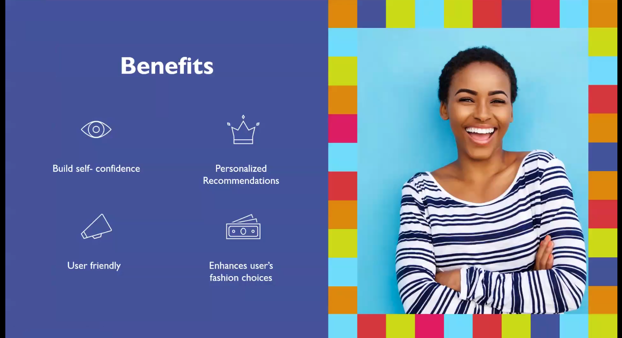

Slide 25
Thank You Being a Patience audience

